Slide 1
Data Visualisation: Empowering Business with Effective Insights
Big THANKFUL TO
Forage
Tata insights and quants
Submitted by:
SaROJ rimal

Slide 2
Steps
There are 4 modules in this virtual experience programme.
Framing the Business Scenario
Choosing the Right Visuals
Creating Effective Visuals
Communicating Insights and Analysis

Slide 3
Report on:
Communicating Insights and Analysis

Slide 4
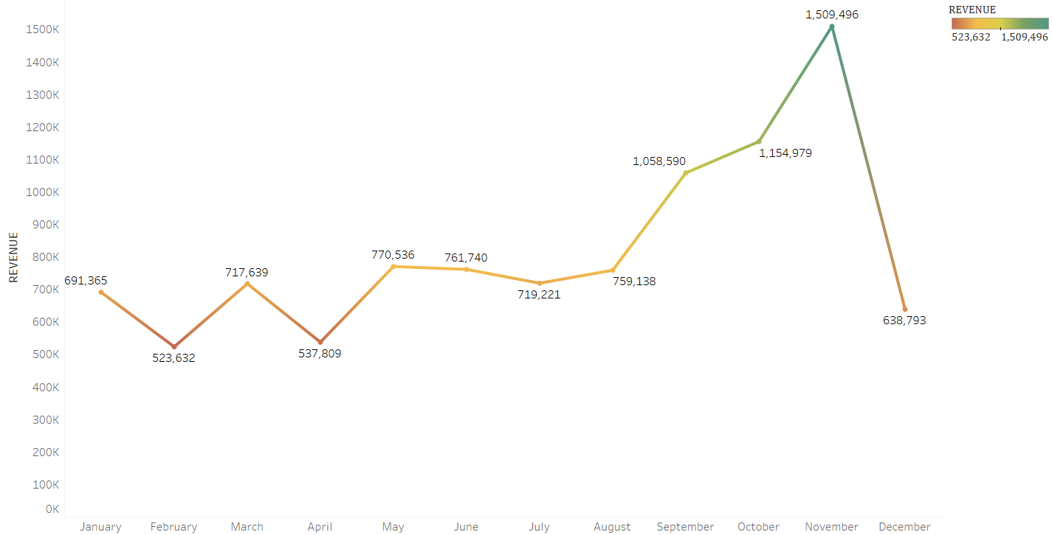
Question 1
The first eight months of sales from January to August were very stable, with an average of $685K (Six hundred eighty-five thousand US dollars) in revenue per month.
The increase in revenue begins in September, when it grows by 40% over the previous month. This pattern persisted up until November, when it rose to 1.5 million US dollars, the largest amount of the whole year.
Unfortunately, since the data for December is insufficient, no inferences can be made from it. This research demonstrates how seasonality—which generally happens in the last four months of the year—affects retail store sales.

Slide 5
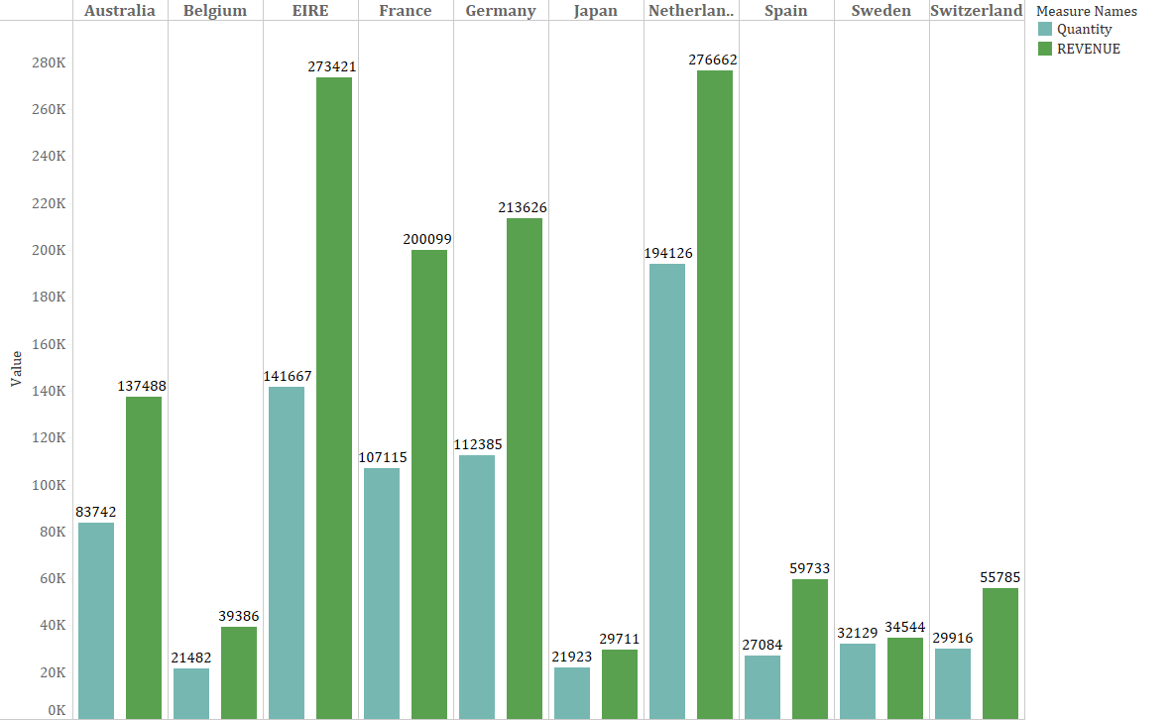
Question 2
Since the UK already has a large demand and I understand you are more interested in nations where demand may be boosted, the UK is not included in these statistics.
The supplied Quantity and Revenue are quite high in nations like the Netherlands, Ireland, Germany, and France. To guarantee that steps are taken to further seize these markets, I would propose concentrating on these nations.
Likewise, the potential markets are Spain, Switzerland and Belgium as we can see that the amount of supplied quantity is half the Revenue generated. If certain focus is given in these areas then there will be more Revenue in the business.

Slide 6
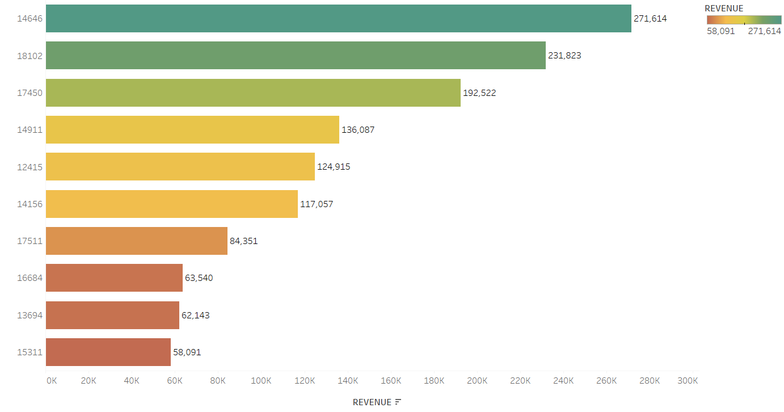
Question 3
According to the statistics, there are not many differences between the top 10 consumer purchases. The fact that the highest revenue-producing consumer only spent 17% more than the second highest demonstrates that the company does not rely solely on a small number of consumers to generate income.
This demonstrates that consumers' ability to negotiate is limited and that the state of business is positive.

Slide 7
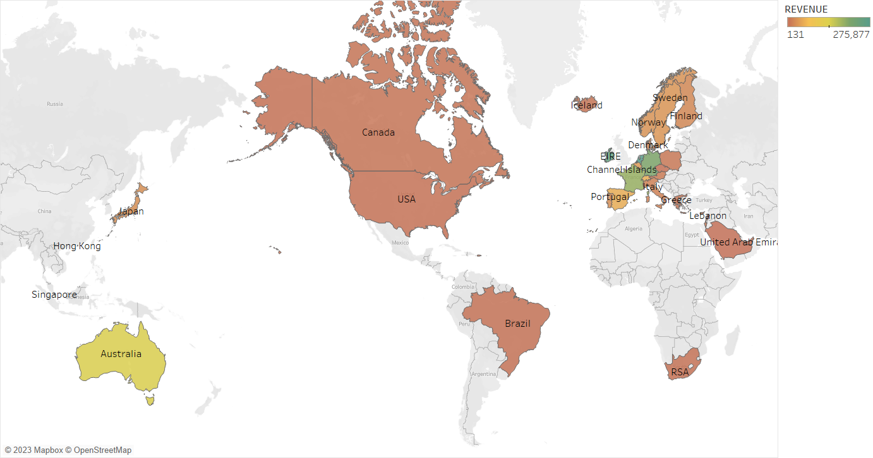
Question 4
Apart from the UK, it is clear that nations like the Netherlands, Ireland, Germany, France, and Australia generate large profits, and the company should invest more in these nations to boost product demand.
The map also reveals that the majority of sales occur only in the European zone, with only a small number in the American region. Along with Russia, there is no market for the items in Africa or Asia. Sales revenues and profitability might increase with the implementation of a fresh strategy focused on these areas.
In Australia, as per the quantity supplied the revenue generated isn’t well enough might be of some factors so we need to have a deep research on it.

Slide 8
Thank you
Any Questions ????

